Slide 1
Database Systems
Lecture 23
Normalization

Slide 2
Today’s Agenda
Normalization of Relations
Practical Use of Normal Forms
Definitions of Keys and Attributes, Participating in Keys
First Normal Form

Slide 3
Normalization of Relations
Normalization: The process of decomposing unsatisfactory "bad" relations by breaking up their attributes into smaller relations
Normal form: Condition using keys and FDs of a relation to certify whether a relation schema is in a particular normal form

Slide 4
Definitions of Keys and Attributes Participating in Keys (1)
A superkey of a relation schema R = {A₁, A₂, ...., A_{n}} is a set of attributes S subset-of R with the property that no two tuples t₁ and t₂ in any legal relation state r of R will have t₁[S] = t₂[S]
A key K is a superkey with the additional property that removal of any attribute from K will cause K not to be a superkey any more.

Slide 5
Definitions of Keys and Attributes Participating in Keys (2)
If a relation schema has more than one key, each is called a candidate key. One of the candidate keys is arbitrarily designated to be the primary key, and the others are called secondary keys.
A Prime attribute must be a member of some candidate key
A Nonprime attribute is not a prime attribute—that is, it is not a member of any candidate key.

Slide 6
First Normal Form
Disallows multivalued attributes, composite attributes, and their combinations.
It states that the domain of an attribute must include only atomic (simple, indivisible) values and that the value of any attribute in a tuple must be a single value from the domain of that attribute.
In other words, 1NF disallows relations within relations or relations as attribute values within tuples.

Slide 7
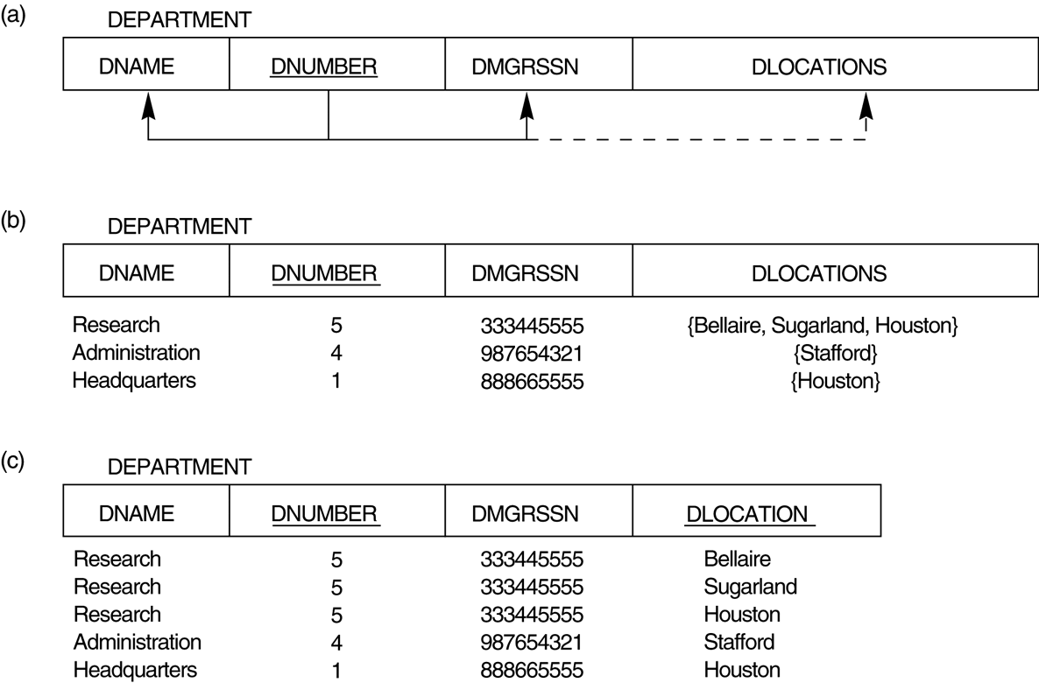
Figure 10.8 Normalization into 1NF

Slide 8
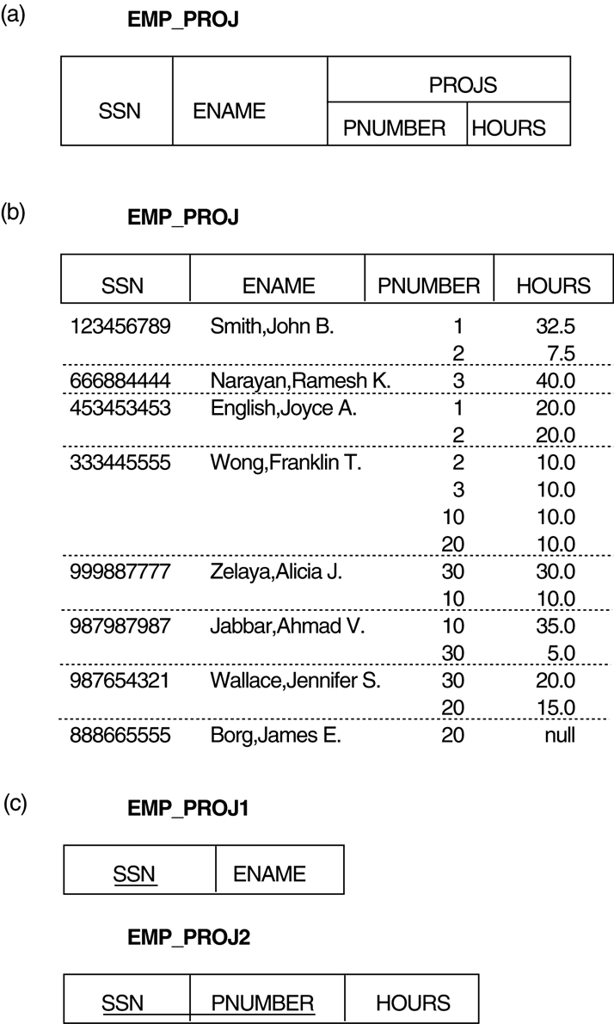
FIGURE 10.9 Normalizing nested relations into 1NF. (a) Schema of the EMP_PROJ relation with a “nested relation” attribute PROJS. (b) Example extension of the EMP_PROJ relation showing nested relations within each tuple. (c) Decomposition of EMP_PROJ into relations EMP_PROJ1 and EMP_PROJ2 by propagating the primary key.

